Slide 1
Electricity and Electrical Circuits
Part 1 - Introduction
Integrated Science
Glencoe
Chapter 13

Slide 2
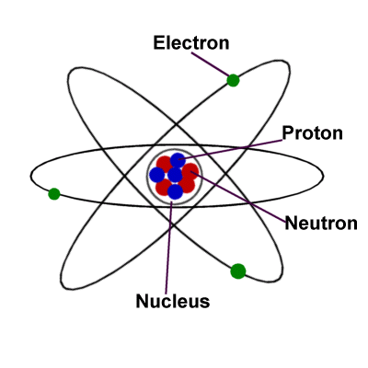
As we have seen in our study of chemistry, matter is composed of atoms, which are composed of protons, neutrons, and electrons.

Slide 3
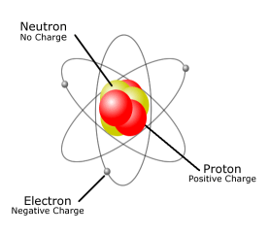
The protons are positively charged and are found “locked” in the nucleus with the neutrons.
The electrons are negatively charged and are moving around in the electron clouds, and are not “locked” into position.

Slide 4
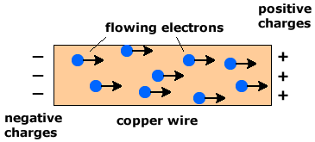
In fact, electrons can and do move between atoms, and can be transferred to other materials and move around quite freely at times.
This “free movement” of electrons is what we call electricity.

Slide 5

Remember the Law of Conservation of Energy, which states that energy cannot be created or destroyed, but may only change form. This law applies here as electrical charges can be transferred between objects.

Slide 6
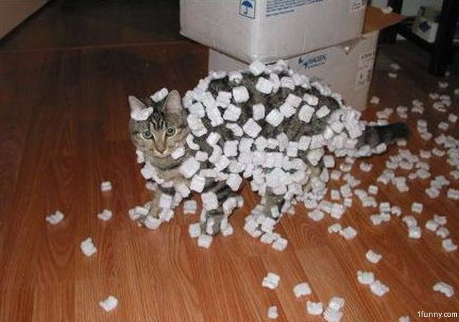
If you have ever experienced the discharge of static electricity as you walk around on carpet in your socked feet and then get shocked when you touch something, then you know that charge can be transferred.

Slide 7
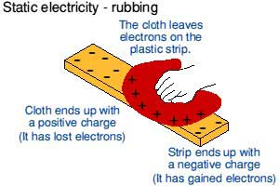
Anytime objects touch each other, there is a transfer of electrons, as the electrons in the outer energy levels of an atom, are held less tightly, and can be torn away.

Slide 8
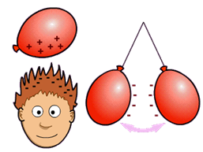
If there are enough extra electrons accumulating, then the object starts to get “charged” up and has a noticeable difference in charge.

Slide 9
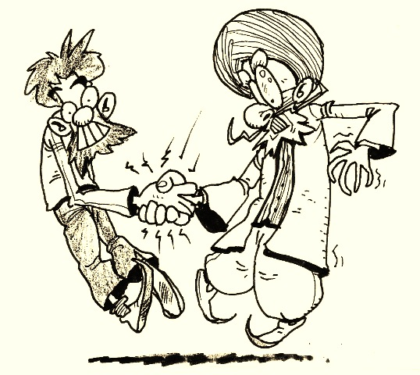
If the charge dissipates quickly, no accumulation can occur.

Slide 10
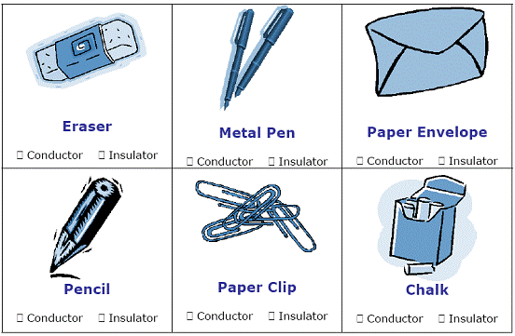
Different materials allow the flow of energy, in our case electrons, to varying degrees.

Slide 11
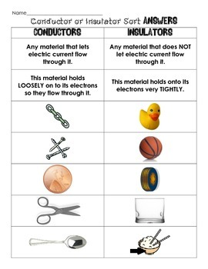
Materials that allow the easy flow of electrons are called conductors.
Materials that do not allow the easy flow of electrons are called insulators.

Slide 12
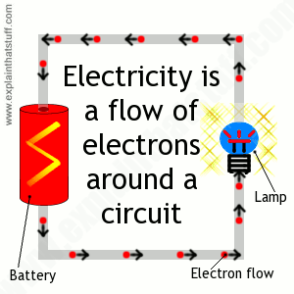
The rate of movement of electrons can be measured over a certain amount of time.
The current is defined as the rate of charge movement or the movement of electrons through an area over a given amount of time.

Slide 13
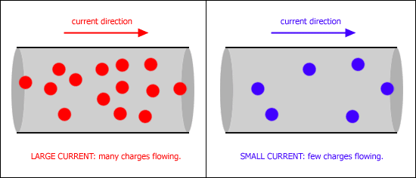
The faster the movement of electrons the higher the current.

Slide 14
Sometimes the flow of electrons is slowed down by any number of factors. These factors include:
Materials – what the electrons are moving through
2. Temperature – how warm or cold the materials are
3. Length – how far the electrons need to move
4. Cross section – how wide the area is the electrons are
trying to move through

Slide 15
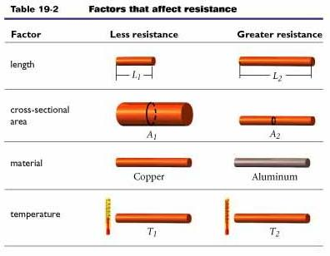

Slide 16
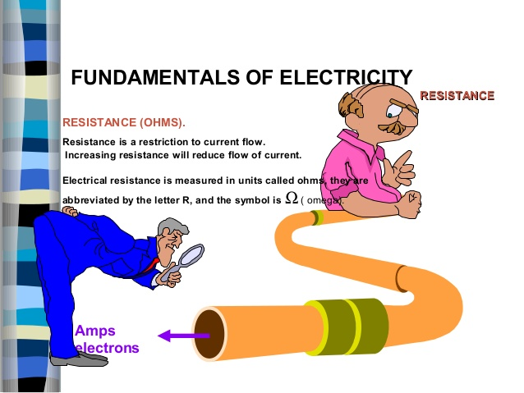
A second concept to deal with is resistance. Anything that slows down the flow of electrons is defined as resistance.

Slide 17
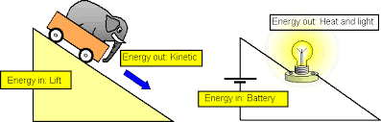
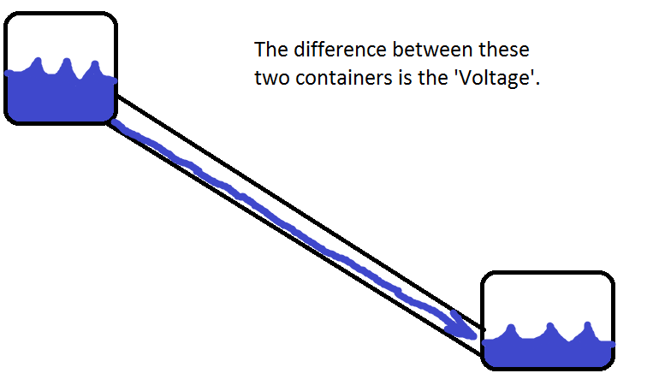
A third concept of electricity is potential difference, which is defined as the change in electrical potential energy between two points.

Slide 18
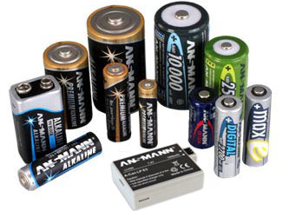
For example, a 9 volt battery has a difference in electrical potential energy of 9 volts between the two terminals of the battery. One is at zero volts, and as the electrons are moved through the battery, they gain 9 joules of electrical potential energy.

Slide 19
Since charge is measured in a unit called coulombs and energy is in joules, as the charges gain energy the potential difference is 9 joules per coulomb = 9 volts of potential difference.
We will be using these three concepts as we next look at electrical circuits and how electricity can be manipulated to many things.

Slide 20
Electricity and Electrical Circuits
Part 2 - Circuits
Integrated Science
Glencoe
Chapter 13

Slide 21
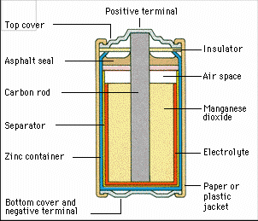
In our study of electricity, it is important to remember that energy is constantly converted in the following manner:
Chemical potential energy
is converted to electrical
potential energy in a battery.
2. Electrical potential energy is changed to thermal
energy, light, mechanical energy as the electricity
moves through the different materials.

Slide 22
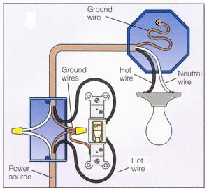
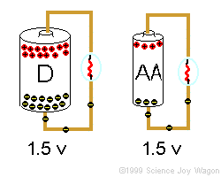
To be able to effectively use electricity, one must understand how electricity moves through different materials in a pathway.

Slide 23
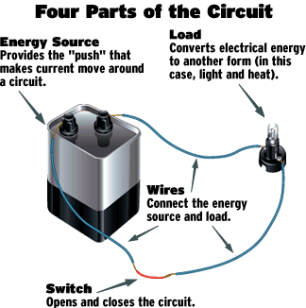
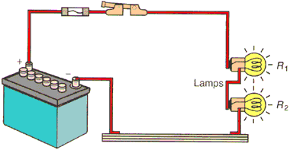
In science, we can build and draw models of the paths electricity can take.
The physical models we build are called electrical circuits. Electrical circuit is defined as a set of electrical components connected to
provide one or more
complete paths for
movement of charge.

Slide 24
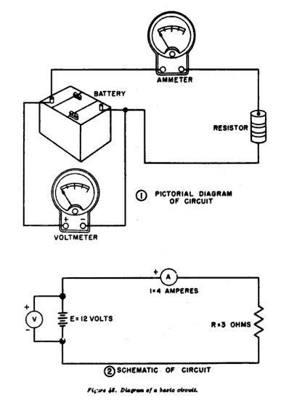
The drawings are called Schematic diagrams. Schematic diagrams are defined as graphical representations of an electrical circuit.

Slide 25
There is a standard set of scientific symbols used to represent different components in a circuit. The most commonly used symbols and what they represent are listed below, we will use these symbols in our drawings.
Component | Wire | Bulb / Lamp | Battery | Resistor | Open Switch | Closed Switch
Diagrams

Slide 26
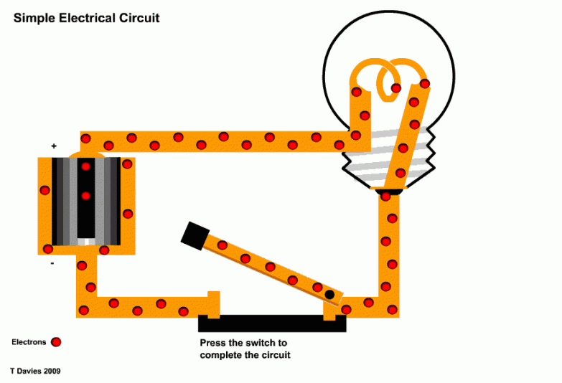
General Circuit Information
A circuit is a complete path for the electrons to follow as they flow, if the path is not complete, there can be no flow between two points.

Slide 27
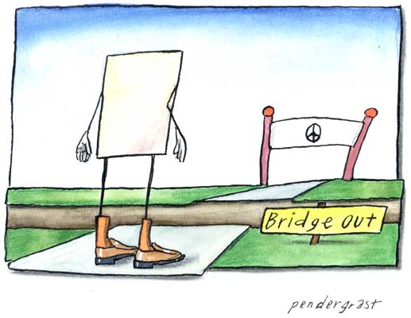
It would be like a road from your home to the store, with a bridge out and no alternative route. There must be a way to get around the broken bridge if you want to get where you are going.

Slide 28
Sometimes a circuit is complete but there is a problem of the current flowing too fast. This is called short circuit.
Short circuit – a circuit which contains little or no resistance
→ The components get too hot due to the excess current and not enough resistance to slow it down and can cause fires

Slide 29
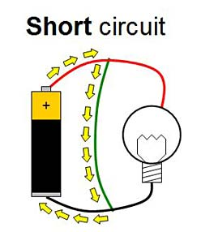
Examples:
- 2 terminals of a battery directly connected
- Uninsulated wires come into contact
→ These are very dangerous

Slide 30
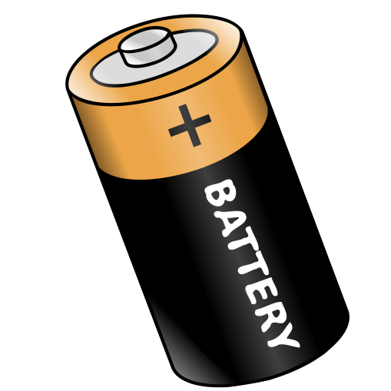
In every circuit there must be a source of the electric current.
This source is known as the EMF – Electromotive force → the energy per unit charge supplied by a source of electric current
→ A source of electrical energy
→ A “charge pump”
→ Examples are batteries and generators

Slide 31
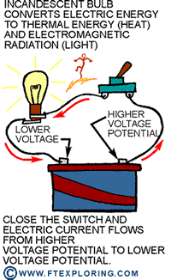
A battery changes chemical potential energy to electrical potential energy as it transfers the energy to the electrons in the battery. As they move along the circuit, the energy is then transferred to the different components, and dissipated (given off) usually as heat, light, or sound.

Slide 32
There are three different types of electrical circuits:
1. Series Circuits - Circuit (or portion of) in which there is a single conducting path without junctions for electricity to follow
2. Parallel Circuits - Circuit (or part of) where components are connected across common points and provides separate conducting paths for electricity to follow
3. Complex Circuits – Circuits with some segments being in series and other segment being in parallel to take advantage of the benefits of both

Slide 33
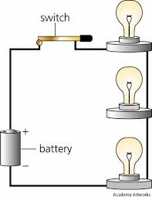
Series Circuits
1. Series Circuits - Circuit (or portion of) in which there is a single conducting path without junctions for electricity to follow

Slide 34
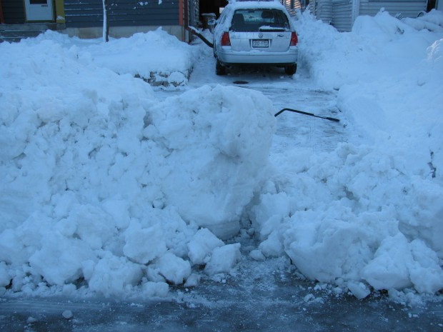
Some of the characteristics of series circuits are listed below and are important to remember when deciding which type of circuit to use.
Back to our road
to the store
example, in a
series circuit there
is one road and
one road only.
If part of the
road is out,
you cannot
get where you
want to go,
no exceptions.

Slide 35
All bulbs / resistors / components in series will have the same current. This is because the current can only flow as fast as the slowest (most resistant) component will allow.
The total current in a series circuit depends on the number of resistors present and resistance of each.

Slide 36

The Equivalent resistance (symbolized R_{eq} ) also known as the total resistance = sum of all resistances in a circuit from all components
Series circuits require all elements to conduct, no broken parts, or the current stops.

Slide 37
Below is a list of advantages and disadvantages of series circuits (notice some may be both)
Advantage of series circuits:
1. Good for regulating current (all parts have same current)
2. Good for reducing current on individual parts
3. Current stops if a component breaks

Slide 38

Disadvantages of series circuits:
1. All parts have same current
2. If one part breaks, the whole circuits fails

Slide 39
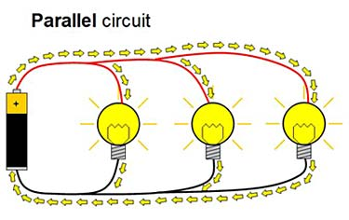
Parallel Circuits
2. Parallel Circuits - Circuit (or part of) where components are connected across common points and provides separate conducting paths for electricity to follow

Slide 40
Some of the characteristics of parallel circuits are listed below and are important to remember when deciding which type of circuit to use.
Back to our road to the store example, in a parallel circuit there is more than one road you can use as a possible route to the store. If one part of the road is out, you can choose a detour around it to still get where you want to go, or if the whole road is working, you can choose your path among several to get to the store.

Slide 41
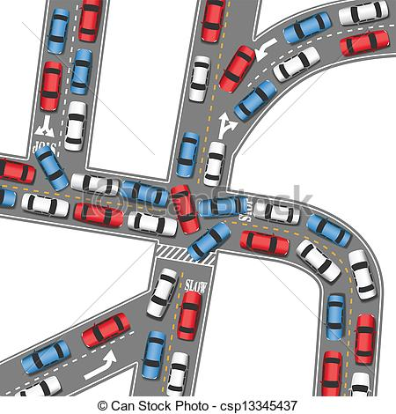

Slide 42
Parallel circuits give multiple alternate pathways for current flow
Resistors in parallel have same potential difference across them. The voltage is the same for all parts, but the current will be different for each part based upon the resistance of each individual component. More resistance in one part equals a slower current in that part.
The sum of currents in parallel resistors = total current

Slide 43
Below is a list of advantages and disadvantages of parallel circuits (notice some may be both)
Advantages of parallel:
1. Parallel circuits do not require all elements to conduct
2. One part can malfunction and the rest will continue to work
3. Potential difference does not change for all components when
one component fails
→ Allows for standardization of products
→ Allows manufacturers to regulate current through a product by resistors
→ Home wired in parallel
Disadvantages of parallel:
1. Current will change if one component fails
2. Current different in all components

Slide 44
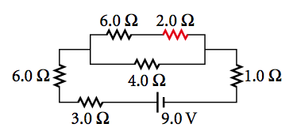
Complex Circuits
3. Complex Circuits – Circuits with some segments being in series and other segments being in parallel to take advantage of the benefits of both

Slide 45
It is common in homes to have multiple outlets in parallel to each other and in series with all those outlets a fuse/circuit breaker
→ allows identical potential difference but safety from overload of current

Slide 46
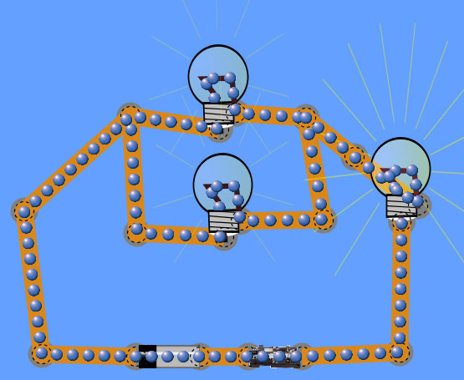
Back to our example of the trip to the store, there may be multiple roads to take to get to the store, but still only one bridge across the river, and if the bridge is out, you cannot cross even with many roads to that bridge.

Slide 47
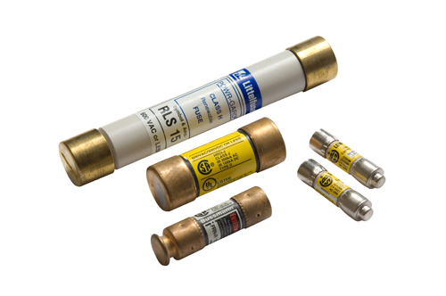
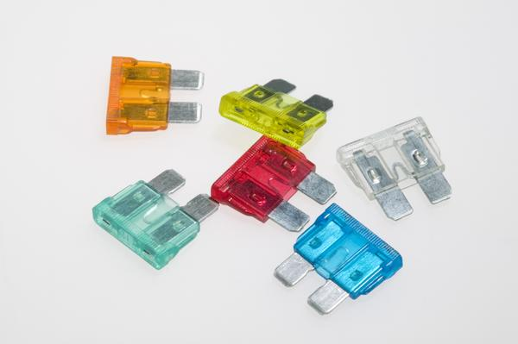
Fuse - small metallic strip that melts when current becomes too high.
→ Replacement necessary when melted

Slide 48
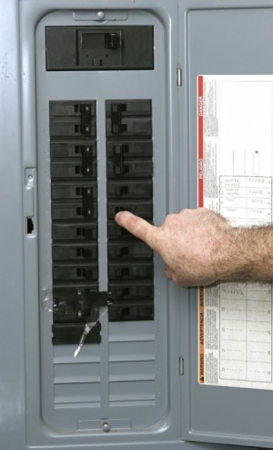
Circuit breaker - device that triggers a switch to open circuit when current is too high
→ reset switch when opened
Both are specially designed
for specific amounts of
current

